Slide 1
Stage | 2021 | 2022 | 2023 | 2024
Bud break | Apr 14 | Apr 9 | Apr 20 | Apr 15
Fully flowering (>50%) | Apr 27 | Apr 29 | May 5 | Apr 21
Flowering finished | May 3 | May 5 | May 10 | May 5
Days in bloom | 19 | 26 | 21 | 21

Slide 2
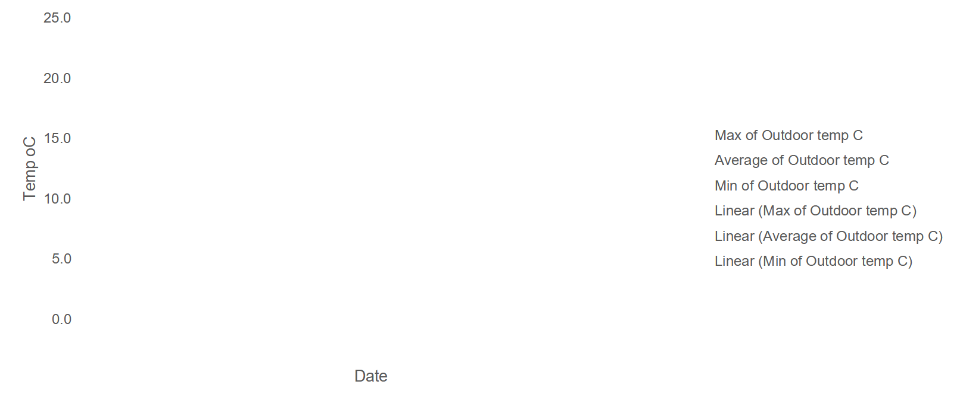
Daily temperatures 2024
Note: weather data missing for Apr 17 - 23rd

Slide 3
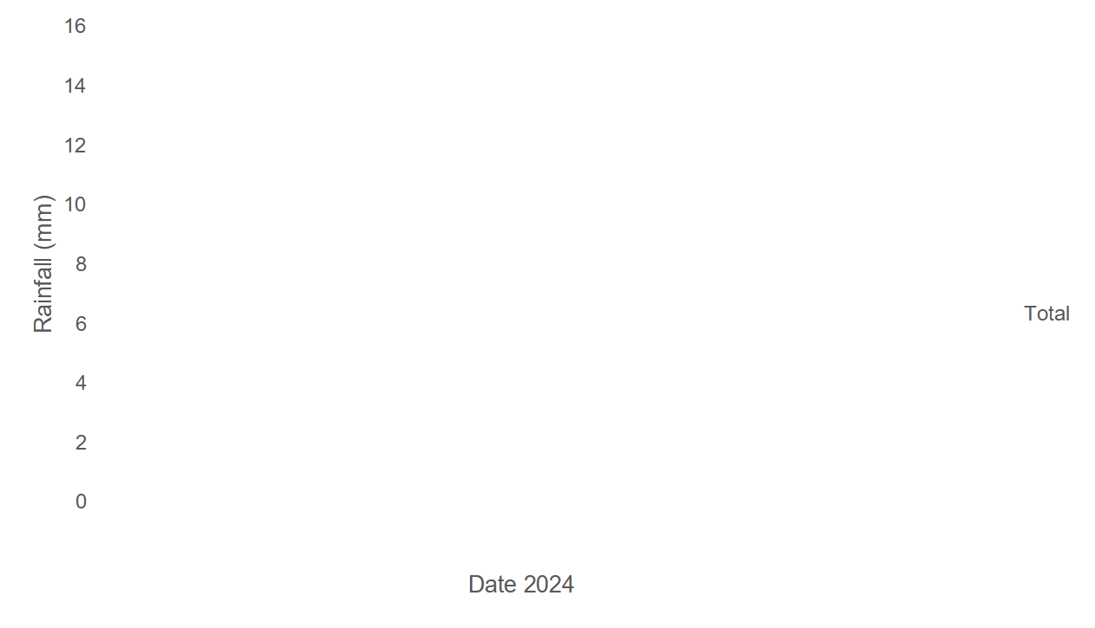
Daily precipitation 2024
Note: Missing data between Apr 17 - 23. Using Saturna as reference approx 1.5 mm on Apr 20 and 0.5 mm on Apr 22nd
Rainfall during blooming (Apr 15 – May 5; 21 days): 22.1 mm + 2 mm for missing data = 24.1 mm

Slide 4
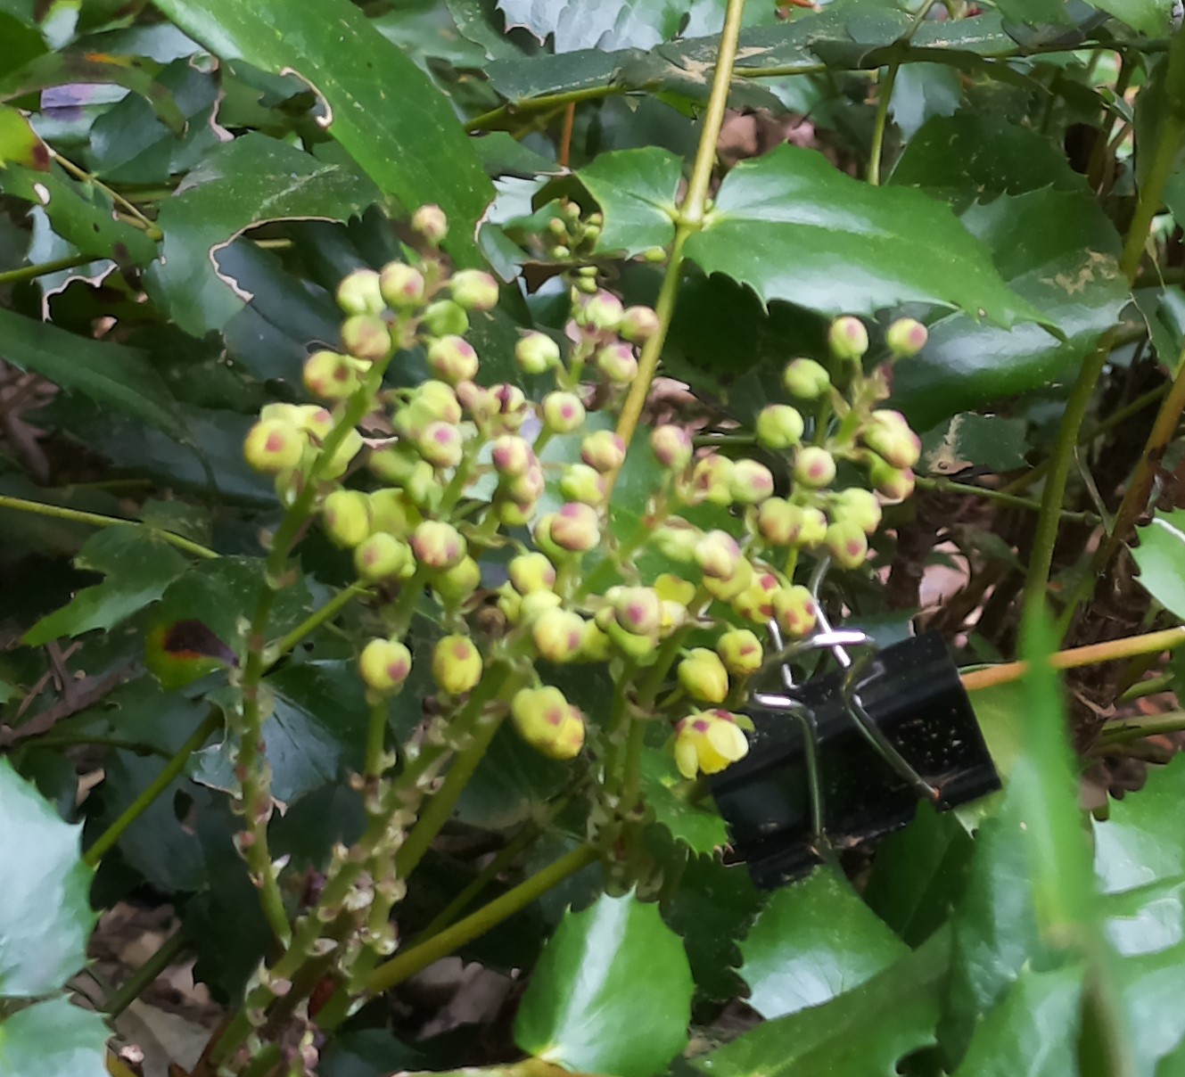
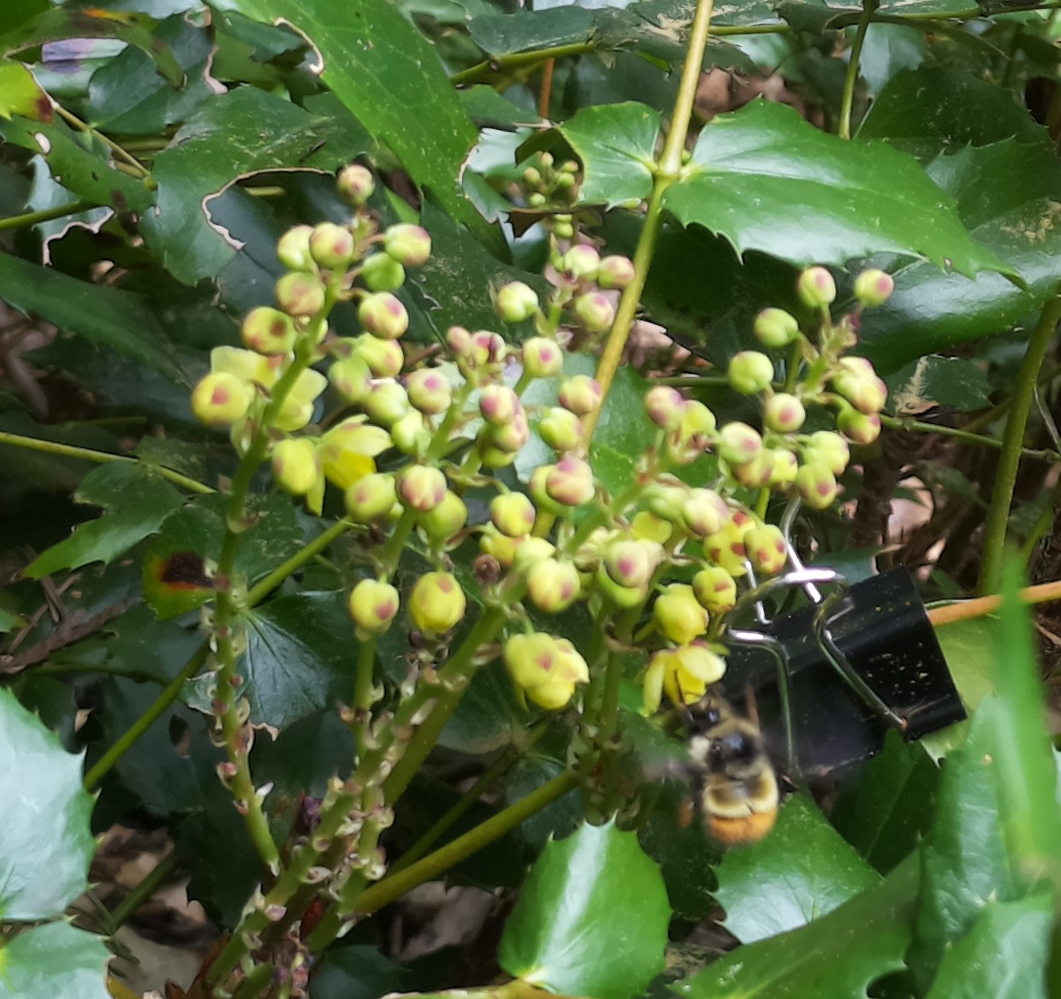

Slide 5
Date | Avg. Temp 2 wks. prior to bloom | Rainfall 2 wks. prior to bloom | Avg. Temp during blooming | Rainfall during blooming
2021 | 6-8 °C | 2 days, 3mm | 9-12 °C | 5 days, 12.7mm
2022 | 6-8 °C | 6 days, 33.8mm | 10-12 °C | 16 days, 96.5 mm
2023 | 5-6 °C | 9 days, 27.6 mm | 10-12 °C | 9 days, 23.8 mm
2024 | 8-10 °C | 3 days, 10.4 mm | 10-12 °C | 8 days, 25.0 mm

